Slide 1


Unit -1
Multidisciplinary Nature of
Environment
Environmental Studies
CO1 - explain multi-disciplinary nature of environment, its component and degradation.
Prof. Arjun Chavada
Civil Engineering Department
arjun.chavada@darshan.ac.in
8200802523

Slide 2

Looping
Topics
  Multidisciplinary nature of environment
  Scope of environment
  Component of environment
  Interaction between components of environment
    Man & environment
  Impacts of Technology on Environment
  Environmental degradation
  Environmental education
  Role of environmental engineer

Slide 3
Multidisciplinary Nature of Environment

Slide 4
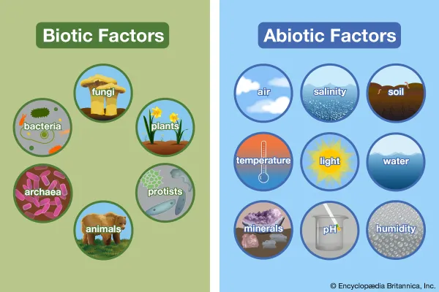
Introduction
Environment simply means external surroundings and conditions, which directly or indirectly affects living organisms (living thing).
The word environment is derived from, French word “environner” which means “to encircle/surround”.
Environment is usually comprised of
  Biotic – living part
    Human, animal, micro-organisms, etc.
  Abiotic – Non-living part
    Physical factors, climatic factors, etc.
    Air, water, temperature etc.

Slide 5
Multidisciplinary Nature of Environment
Environment science is the study of earth, air, water, and living organisms.
It is highly Multidisciplinary.
  Involving of study different subjects in one activity.
It includes subjects like,
Physical science
Chemical science
Biological science
Geology
  To understand the chemical structure of abiotic components
  To understand energy transfer & its flow.
Sociology
  Helps in understanding socio-economic aspects associated with development activity.

Slide 6
Scope of environment

Slide 7
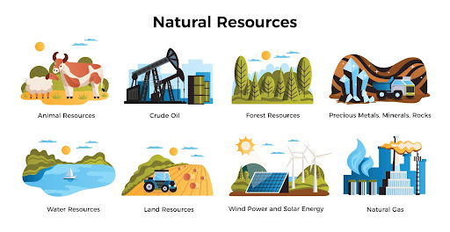


Scope of Environment
Natural Resources:
  Their conservation & management
Ecology and Biodiversity:
  Red data book
Environmental Pollution and Control
Social issues in relation to development and environment
  Sustainable development
Human population and environment:
  Scarcity of resources and related environmental problems
Natural Resources
Unemployment
Human population & environment

Slide 8
Component of environment

Slide 9
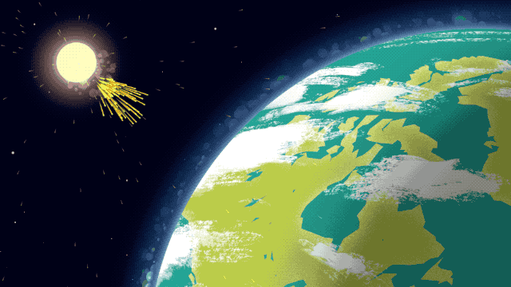
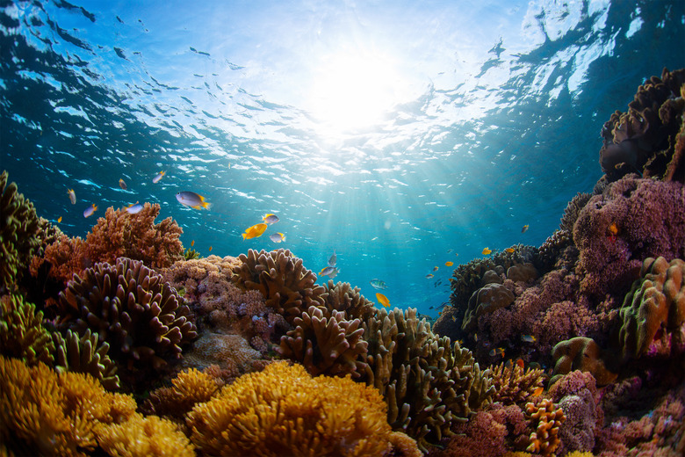
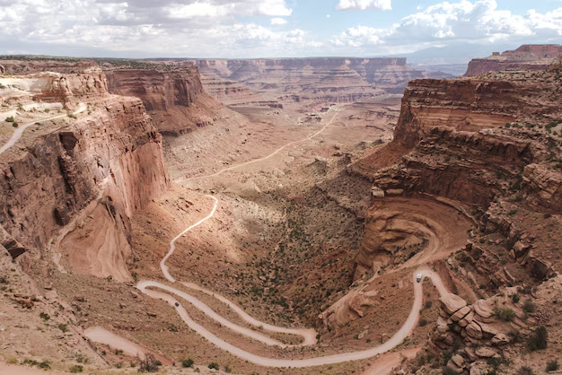

Components of Environment
Atmosphere
Hydrosphere
Lithosphere
Biosphere
Relating to Air
(light + gas)
Relating to Water
Relating to Ground
Relating to Organism

Slide 10
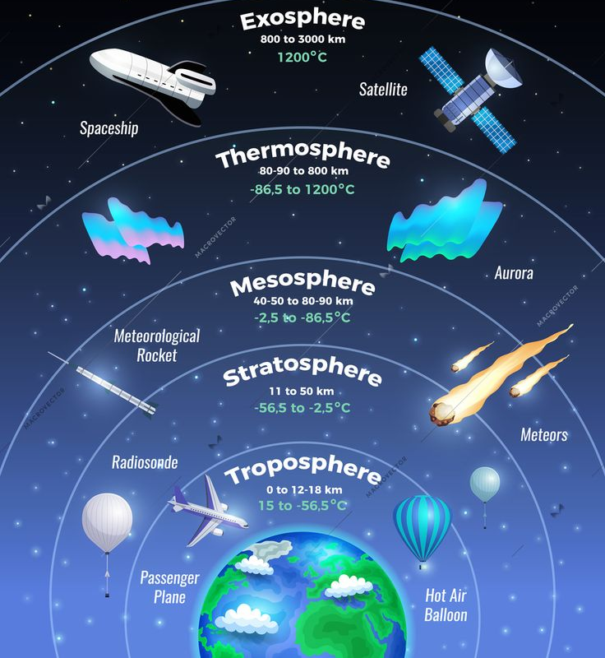
1. Atmosphere
The region surrounding the earth is known as the atmosphere.
Atmosphere is generally a mixture of gases surrounding the Earth.
On the basis of temperature profile and other related phenomena, the atmosphere is divided into the following parts.
  Troposphere
  Stratosphere
  Mesosphere
  Thermosphere

Slide 11

Layers of Atmosphere
a) Troposphere
  First layer above the ground surface.
  Extends up to 12 km.
  Contains most of the gases (75%).
  Temperature here is moderate.
  Major gases in pollution-free dry air are,
    Nitrogen 78% (78.09%),
    Oxygen 21% (20.95%),
    Argon 1% (0.93%),
    Carbon dioxide 0.04%.

Slide 12
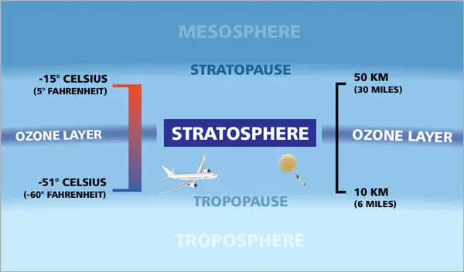
Layers of Atmosphere
b) Stratosphere
  Second layer.
  Extend between12 km to 50 km.
  Contains ozone layer,
    Which protects the earth’s surface from UV radiation, thus increasing the temperature in the upper part.
  Temperature in this layer increases with elevation.

Slide 13
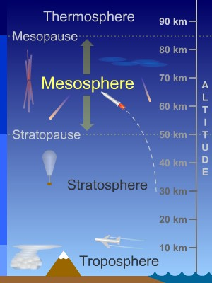
Layers of Atmosphere
c) Mesosphere
  Third layer.
  Extends between 50 km to 80 km.
  This layer protects the earth from meteoroids(Asteroid/ઉલ્કા).
  Meteoroids are burnt in this layer due to frictional resistance.
  It is generally cold but temperature might increase due to meteoroids.

Slide 14
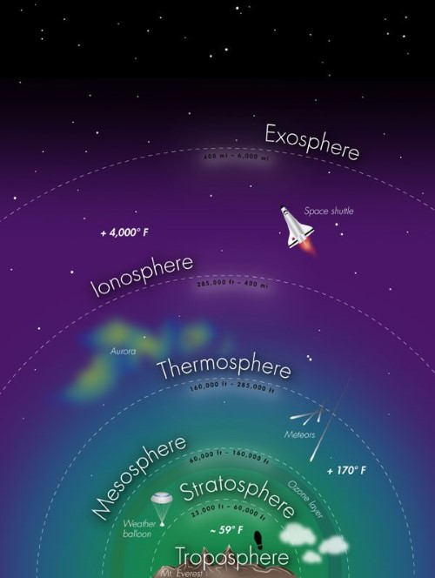
Layers of Atmosphere
d) Thermosphere
  Observed above 80 km and is further divided into 2 parts.
  Ionosphere, which is the lower part. It extends from 80 km to 550 km.
    It helps in radio communication.
  Exosphere is the upper part.
    Air is very thin here and is the area where satellite orbits the Earth.
  Temperature in this region is high.

Slide 15
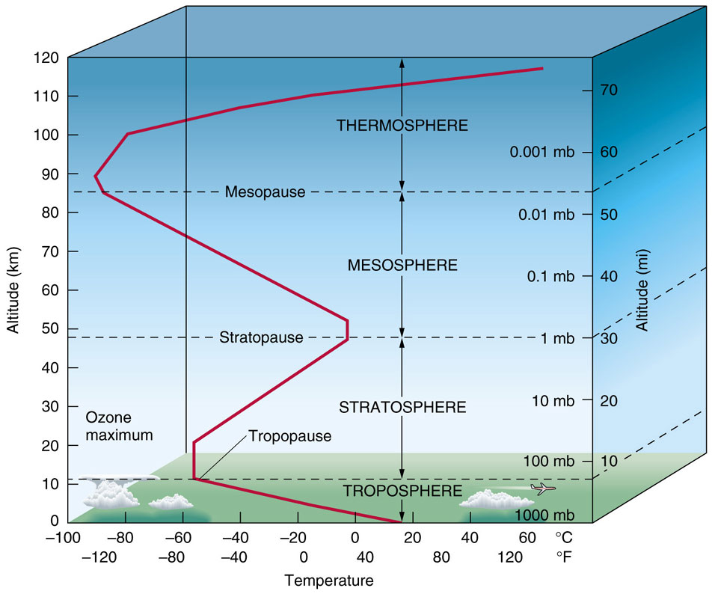
Temperature profile of atmosphere

Slide 16
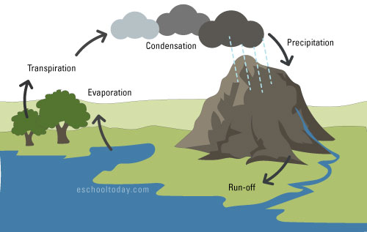
2. Hydrosphere
Hydrosphere covers the environment relating to water.
Movement of water in our environment is called the hydrological cycle.
  Refer the figure given.
Around 75% of the earth’s surficial area is covered with water.
Water can be, either fresh (free from salts) or saline (Salt water) in nature.

Slide 17
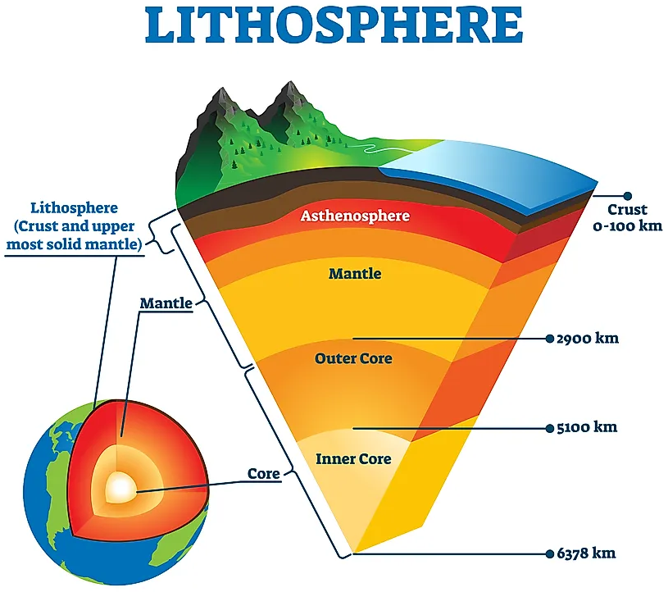
3. Lithosphere
Lithosphere is the uppermost part of the earth crust.
It contains of soil, rock , metal, minerals etc.
Lithosphere plays an important role in,
  Producing food
  Decomposition of most of the organic waste.
This decomposition (વિઘટન) is carried out by micro-organism.
  Bacteria, virus, fungi, etc.

Slide 18
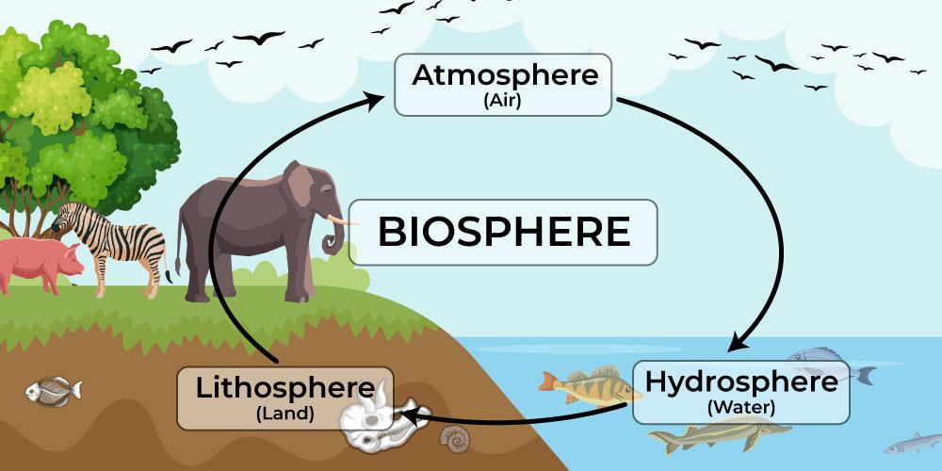
4. Biosphere
Biosphere is made up of living organisms & the environmental constituents supporting the organisms.
“The region of the earth where life exists is known as the biosphere.”
It extends from lowest sea bed level to high in the atmosphere.
Favorable atmosphere conditions like water, sunlight exposure, temperature etc., determines the existence of life.

Slide 19
Interaction Between the Components of Environment
Any change in one of the components effect other components also,
  For example, changes in the temperature of atmosphere, cause changes in the rate of evaporation, humidity Leading to rainfall, it affects lithosphere as flood may occur causing erosion of earth.
  This also affects the biosphere as different types of plants grow differently according to the amount of rainfall they receive.
  Thus, there is a dynamic interaction among different components of environment.
Lithosphere is almost static component, while atmosphere & hydrosphere are dynamic components of environment.
Different types of movements of air, due to wind & storms, and movements of river water cause changes on the land surface and thus affect lithosphere.
Thus, all components of environment are interrelated and have capacity to change the structure and composition of other components of the environment.

Slide 20
Interaction Between the Components of Environment

Slide 21
Interaction Between the Components of Environment
All of the components of environment are interconnected and are continuously in contact of one another.
A schematic representation of environmental components and their interrelationship is shown in the figure.
  Rectangles represents different spheres.
  The lines show the flow path of matter.
  There is closed, dynamic, inseparable interrelationship.
  If one linkage changes other components respond.
Atmosphere
Hydrosphere
Biosphere
Lithosphere

Slide 22
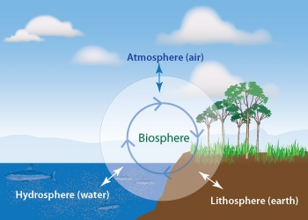
Interaction Between the Components of Environment
Atmosphere acts as a transport media as it provides gases for respiratory purposes for all living organisms.
Water is utilized by living organisms for growth and development.
Lithosphere is a solid shell of inorganic matter on the surface of the earth.
The biosphere implies to all living organisms.

Slide 23

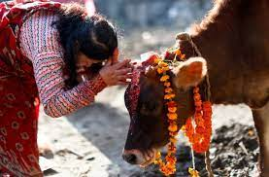
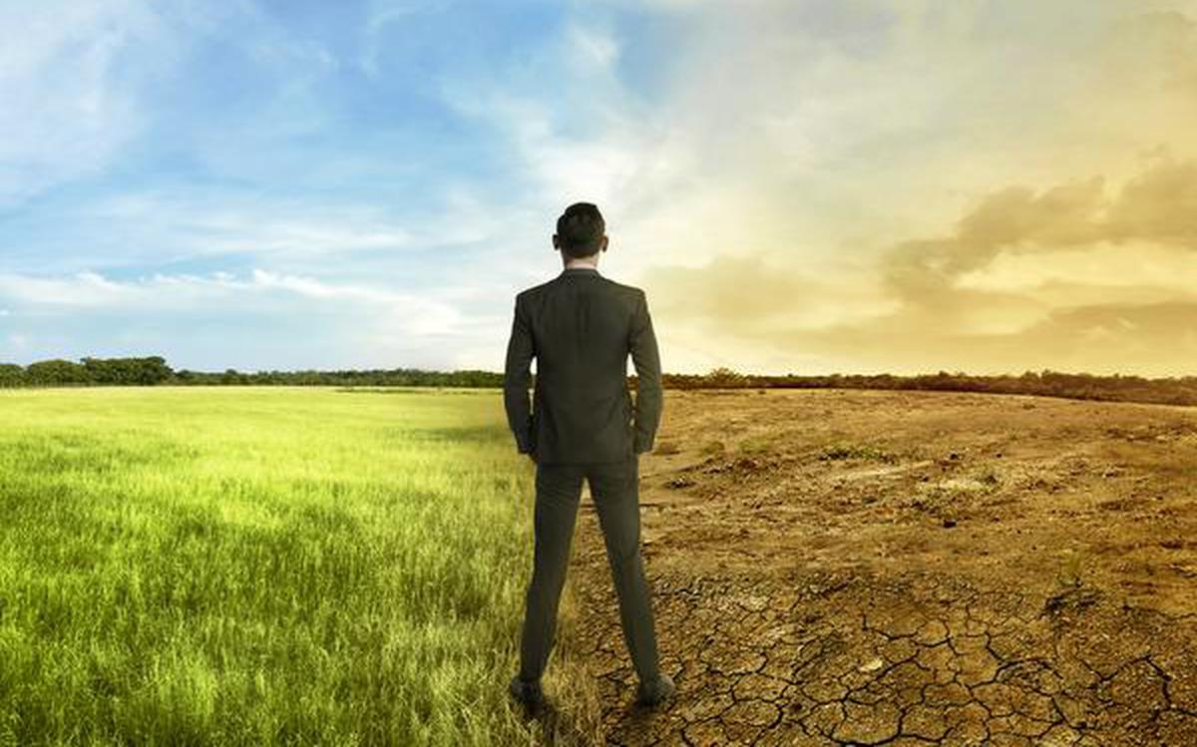
Man & Environment
The two words Man and environment are not new to human history and the interrelation between them is well established.
Worshipping of trees and rivers, animals, and birds was not based on superstition, but there was a hidden message about preserving and protecting the environment.
With the start of the industrial revolution the total scenario changed.

Slide 24
Impacts of Technology on Environment

Slide 25
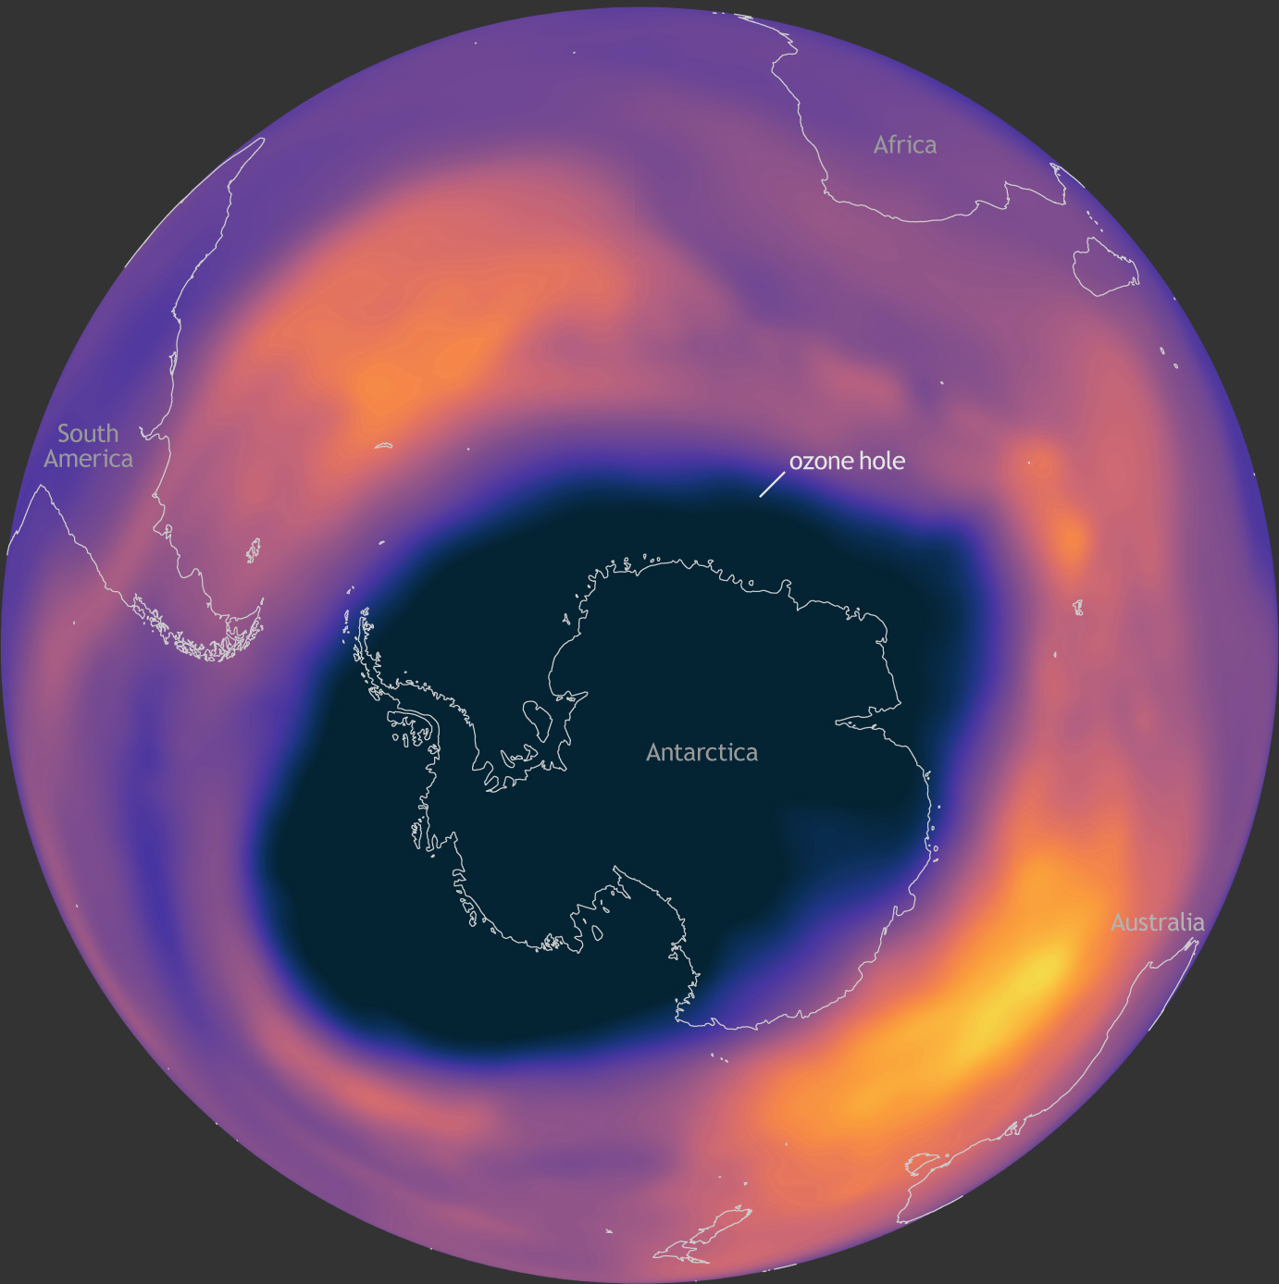
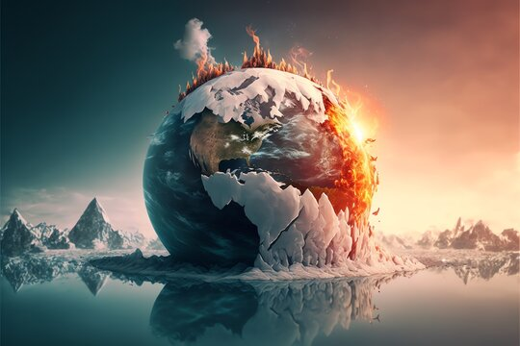
Impacts of Technology on Environment
Human is the only living organism, capable of modifying its surrounding environment, according to the need.
Other animals change according to the environment.
Humans started hunting animals and cutting trees for their basic needs, gradually with time they started cutting forests and converting them into grasslands/agricultural fields.
Quantity of carbon dioxide emission increased tremendously.
Major environmental issues arising due to human activities are global warming, acid rain, and ozone depletion.

Slide 26
Impacts of Technology on Environment
Technology helps ease human labour or may be used for one’s convenience.
No technology can be completely free of environmental impacts.
This statement simply says that the development and use of any technology leads to environmental costs more than its benefits.
The impact of technology can be direct or indirect in nature.
Direct effects includes
  Exhaustion of natural resources.
  Release of pollutants.
  Accidents, etc.
Indirect effects: it interfere with the quality of vital services supplied to living species by nature.
  Life expectancy.

Slide 27


Impact of urbanization on environment
Impact on atmosphere,
Increased release of CO₂, Decreased O₂ production
  Due larger population
Increased average temperature
  Due higher CO₂ and less vegetative cover
Air pollution from combustion of fuels
  Due to vehicles
Particulate matter and noxious fumes

Slide 28
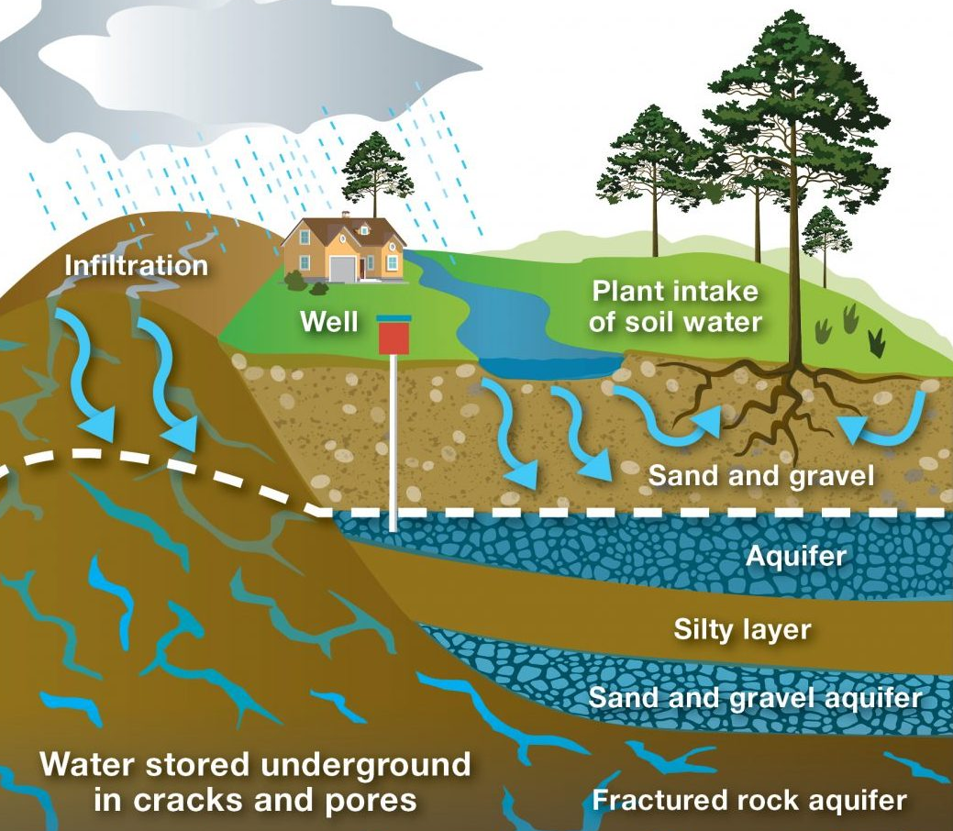
Impact of urbanization on environment
Impact on hydrosphere,
Greater demand/scarcity of water resources
  Due population and various industry and commercial activity
Because of high ground usage,
  There is increase in pollution of water resources
  Drainage patterns affected
Due to transportation Rain and surface water polluted with lead.
Leaching of pollutants from landfills reaches ground water reserves.
  Due to chemicals from waste products.

Slide 29
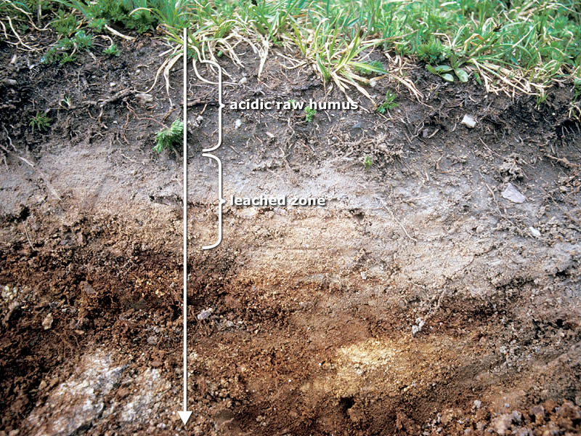
Impact of urbanization on environment
Impact on lithosphere,
Increased land use for residing (living purpose) and decrease in agriculture land
Complete changes due to construction.
  Natural land features affected.
Disruption or disfigurement of the landscape
  Due to roadways and railway construction
Urban waste disposal disturbs lithosphere quality
Leaching

Slide 30
Impact of urbanization on environment
Environmental Component | Population | Land use | Transportation | Services
Atmosphere | Increased release of CO₂, Decreased O₂ production | Increased average temperature | Air pollution from combustion of fuels | Particulate matter and noxious fumes
Hydrosphere | Greater demand of water resources | Increased pollution in most of the resources | Rain and surface water polluted with lead, drainage pattern change | Leaching of pollutants from landfills reaches ground water reserves
Lithosphere | Increased land use for residing and decrease in agriculture land | Complete changes due to construction and landscape. | Disruption or disfigurement of the landscape | Urban waste disposal disturbs the landscape

Slide 31
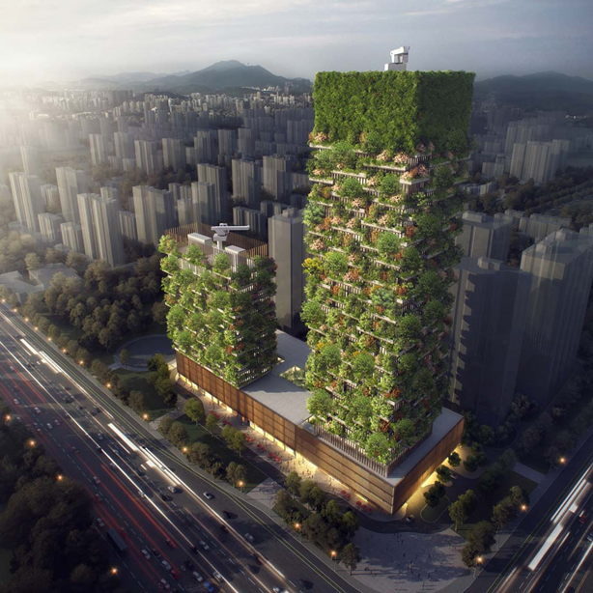
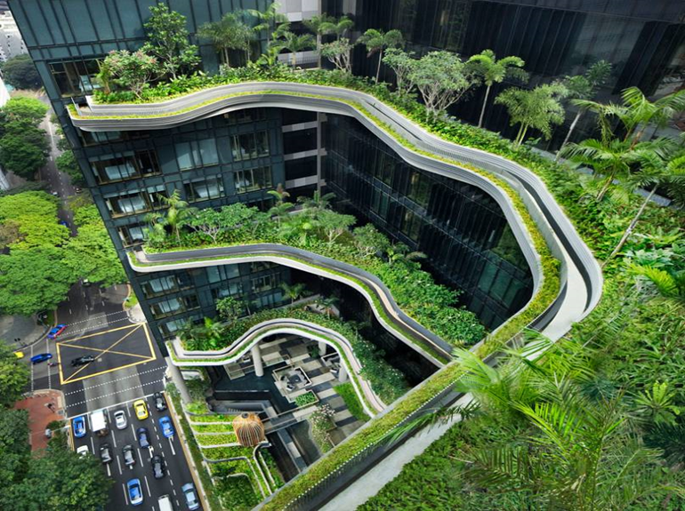
Advances Towards Environmental Conservation
Concept like green building and vertical growth helps easing the adverse effect technology has on environment.
vertical growth
Green building concept

Slide 32
Environmental degradation

Slide 33
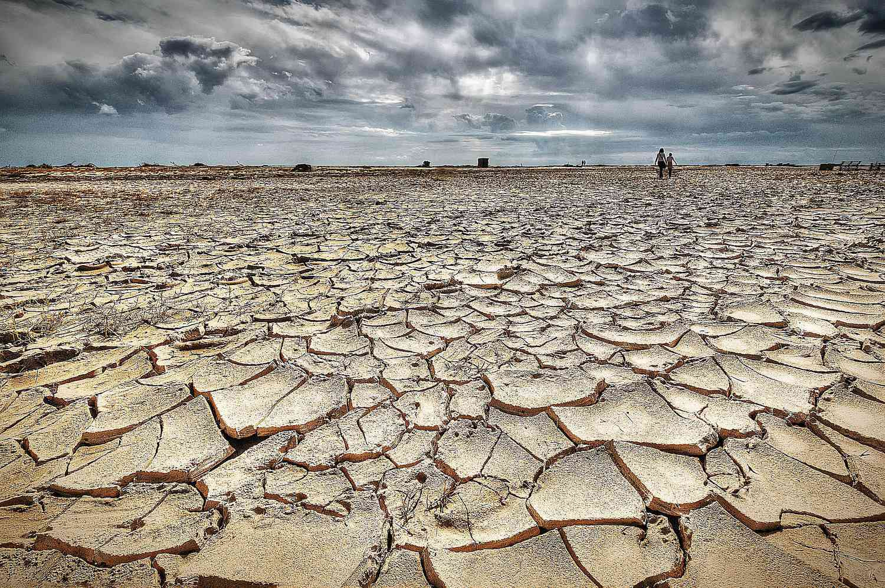
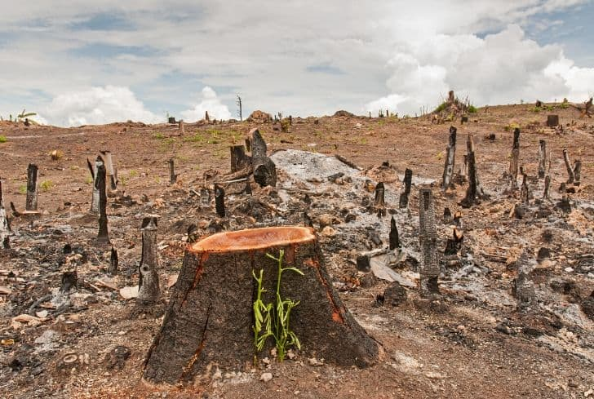
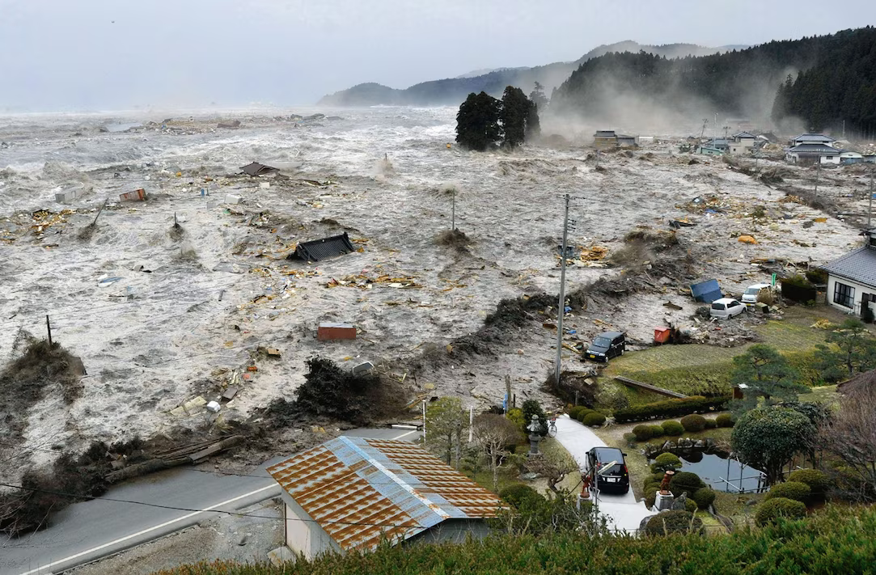
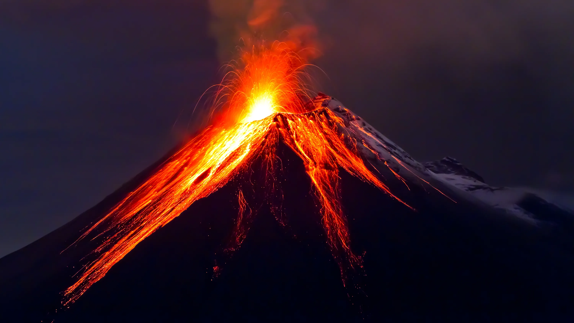
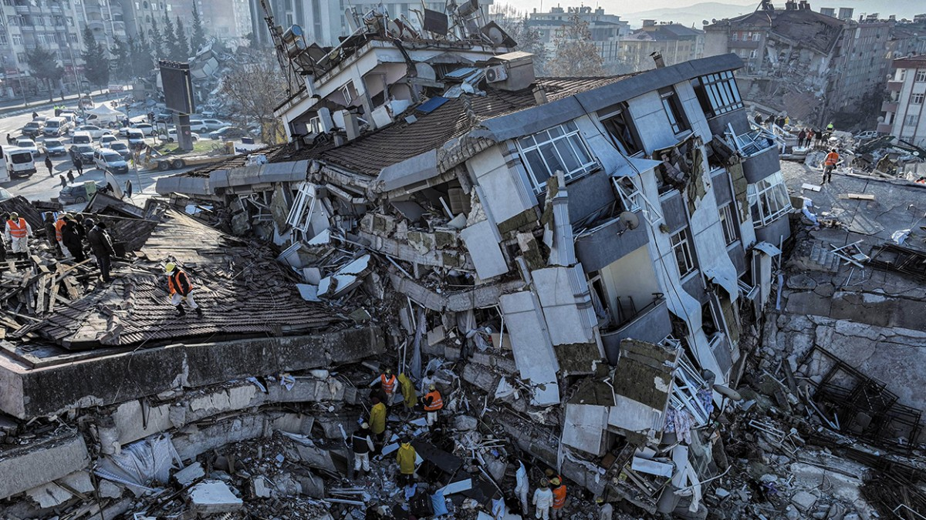
Environmental Degradation
Environment degradation can be defined as “The overall lowering of environmental qualities due to damage caused by both, natural and human activities.”
It is the direct and indirect deterioration of the environmental quality due to different activities that pollute key elements like air, water, and soil.
It can be:
  Natural
    Droughts,
    Storms and floods,
    Earthquakes,
    Tsunamis,
    Volcanic eruptions.
  Man-made
    Deforestation,
    Industrialization,
    Urbanization

Slide 34

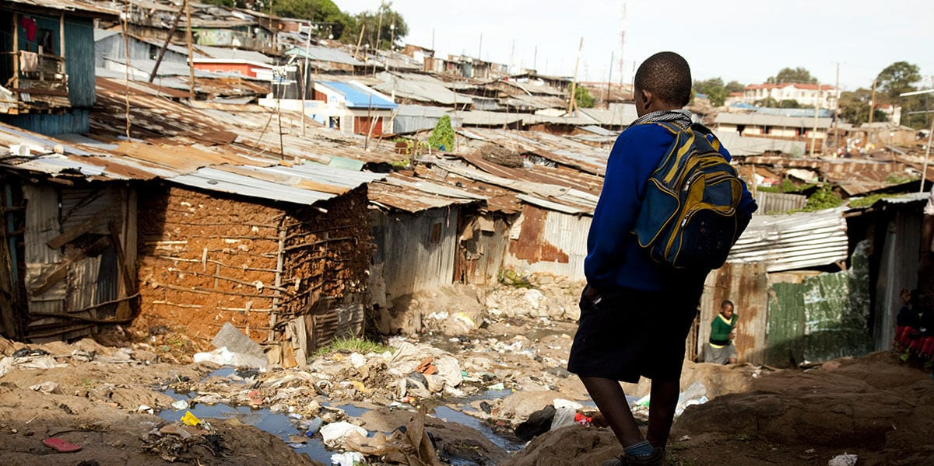
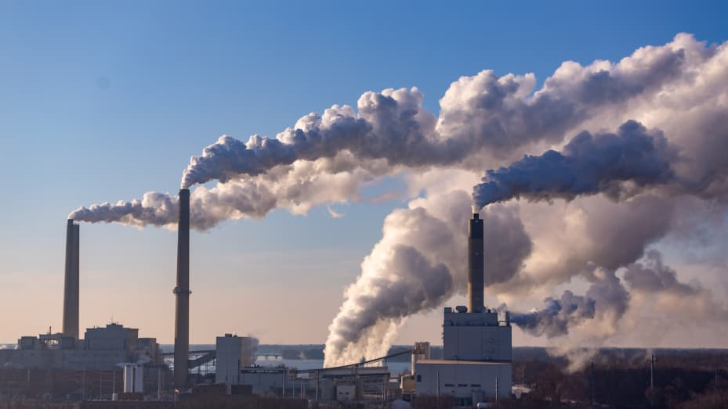
Environmental Degradation
Alarming rate (speed) of population growth has put excessive pressure on all of the natural resources.
Total environmental degradation & pollution, arise mainly due
  Consumption of natural resources by overpopulation of developing countries
  Wasteful overconsumption of natural resources in developed countries.
In developing countries 3 Ps are key factors for rapid environmental degradation.
  Population
  Poverty
  Pollution

Slide 35
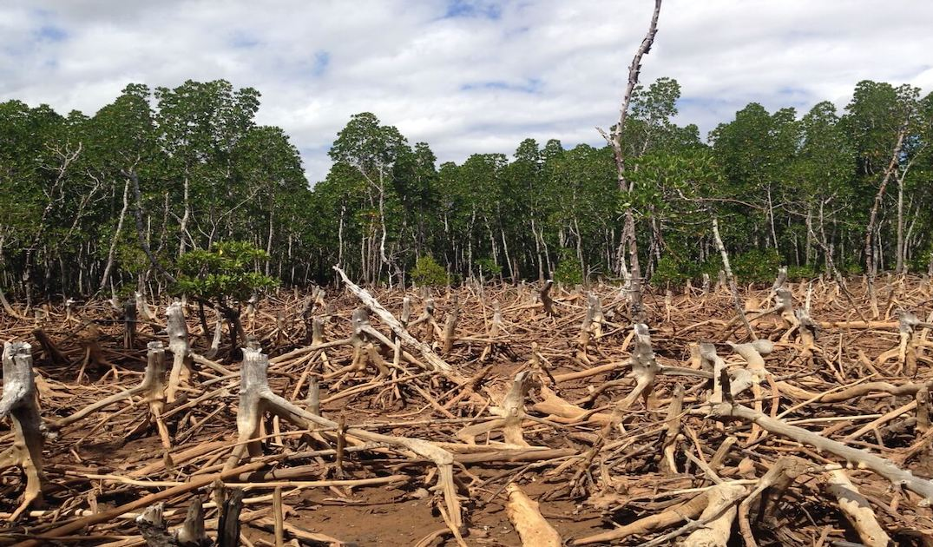
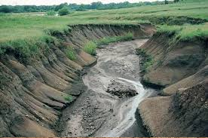
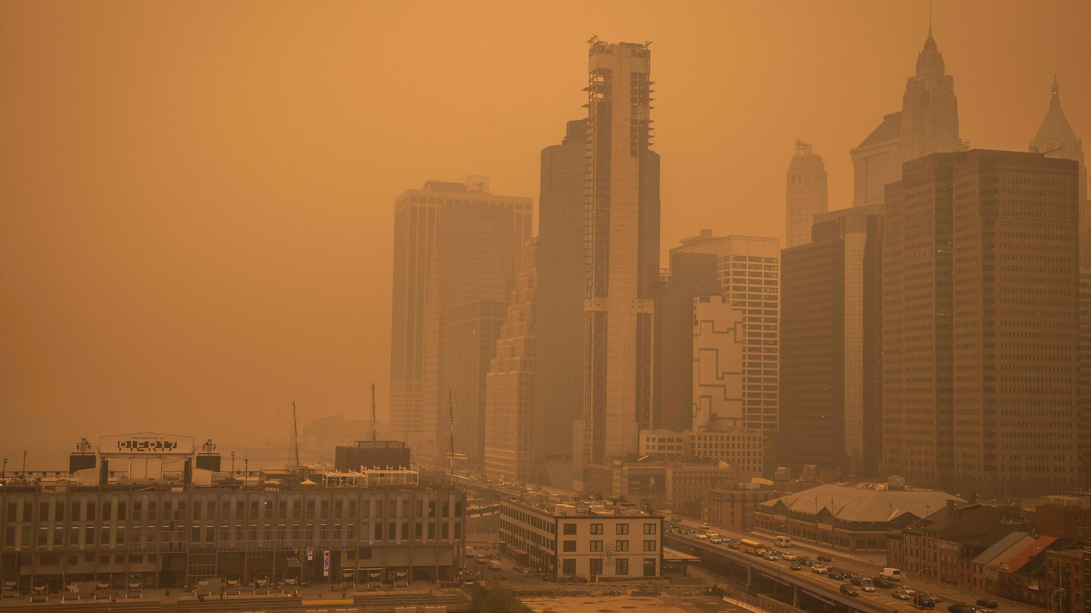
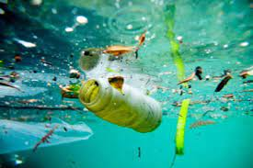
Environmental Degradation
Deforestation
Soil Erosion
Urban Air Quality
Unsatisfactory water quality

Slide 36
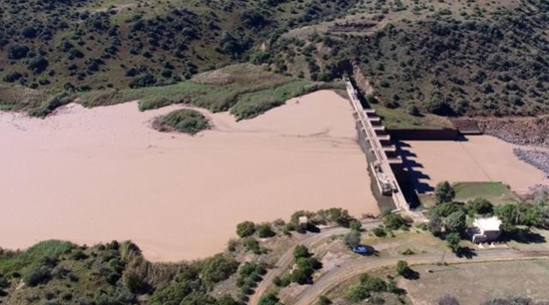
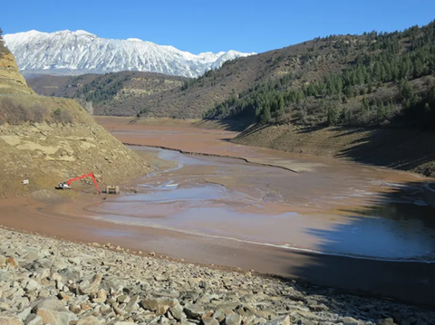
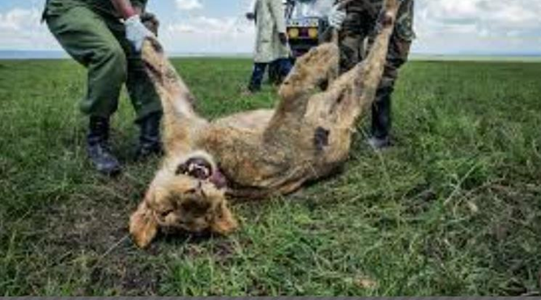
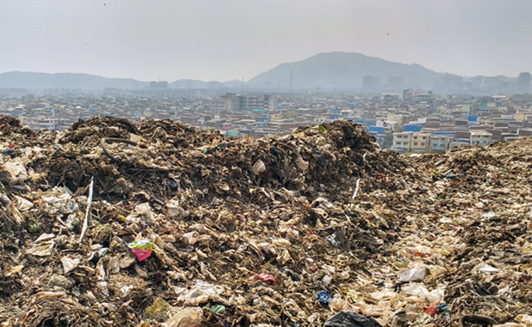
Environmental Degradation
Reservoir are filled with sediments
Watershed are losing storage capacity
Wildlife habitats are eliminated
Solid waste pile up

Slide 37
Environmental Education

Slide 38

Environmental Education
Environmental education is an integral process, which deals with man’s interrelationship with his natural and manmade surroundings, Including,
  The relation of population growth, pollution.
  Resource allocation, depletion, conservation technology.
  Urban and rural planning to the total human environment.

Slide 39
Importance of Environmental Education
The objective of environmental education is to make the public aware of the environmental problems, the importance of environment protection.
It gives a basic understanding of various environmental aspects and associated problems.
It teaches us the concepts of sustainable development and idea about the use of natural resource without damaging it much.
It teaches us how to conserve energy and save our planet.
It develops skills to identify and find remedial measures to overcome the problems.

Slide 40
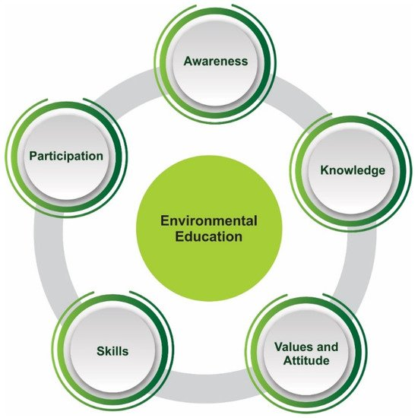
Objectives of Environmental Education
Increase awareness of the total environment
Increase the knowledge of the environment
Improve attitude towards the environment
Provide motivation towards environmental protection.
Increase participation and develop sense of responsibility

Slide 41
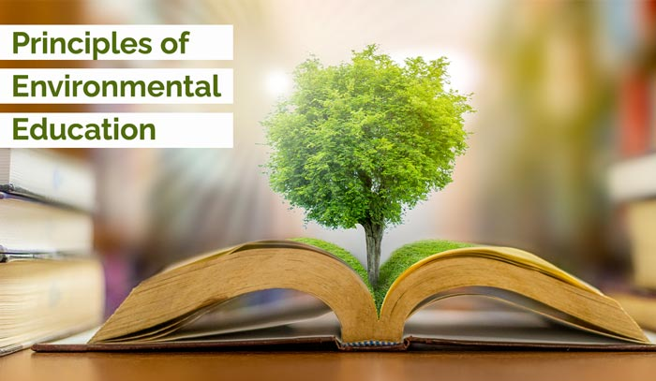
Principles of Environmental Education
Environment education considers environment in totality.
It’s a holistic approach toward sustainable development.
Environmental hazards are controllable and every citizen has a moral obligation towards it.
Put value and necessity of cooperation at personal, local, and national levels in the prevention of problems and solutions for them.
Concerns about the environment are everyone’s.
  Everyone should work together.

Slide 42
Role of Environmental Engineer

Slide 43
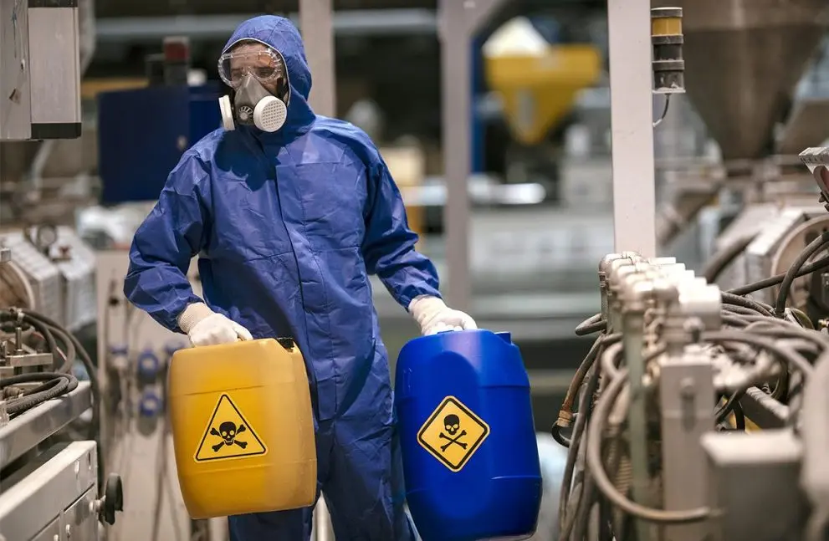
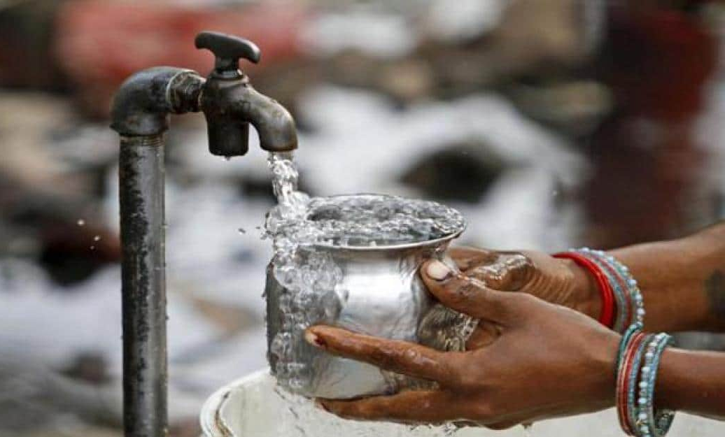
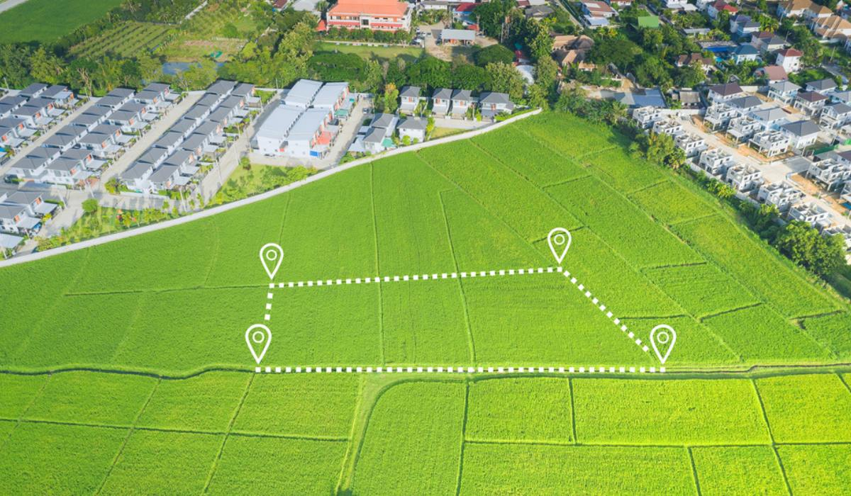
Role of Environmental Engineer
Environmental engineers work in the industrial and research sectors to implement various solutions to control pollution and maximize the planet’s energy resources.
Environmental engineers can have specialization in the following areas;
  Waste management
  Toxic material control
  Water supply
  Solid waste management
  Public health & safety
  Land management
  Air pollution and air quality control
  Industrial Hygiene

Slide 44
Environmental Studies (ES)
Prof. Arjun Chavada
Civil Engineering Department
arjun.chavada@darshan.ac.in
8200802523

